Slide 1
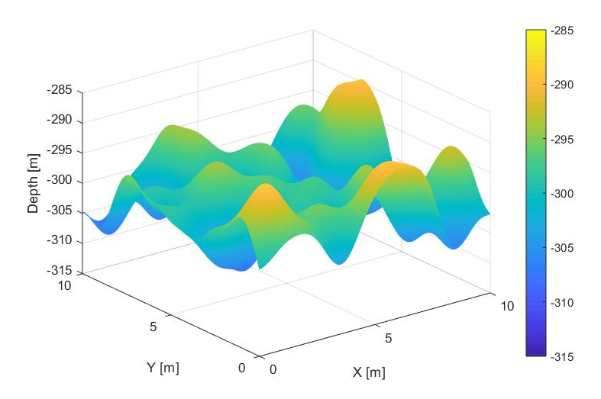
Bathymetry interpolation algorithms using AUV mission data
Alessia Annecchini
Alessia Guida
Lorenzo Irace
Giuseppe Longo

Slide 2
Previously on this topic
Most performant algorithms
Ideal case: spline interpolation
Noise: kriging and spline interpolation
Outliers: kriging and linear interpolation
But kriging is slow...
Performances indexes: MSE and execution time (computing 95% confidence interval on 5 repetitions)
Seabed composition and water absorption
GUI setup

Slide 3
Lineup
Outliers + noise
Mission physical bounds
Samples density

Slide 4
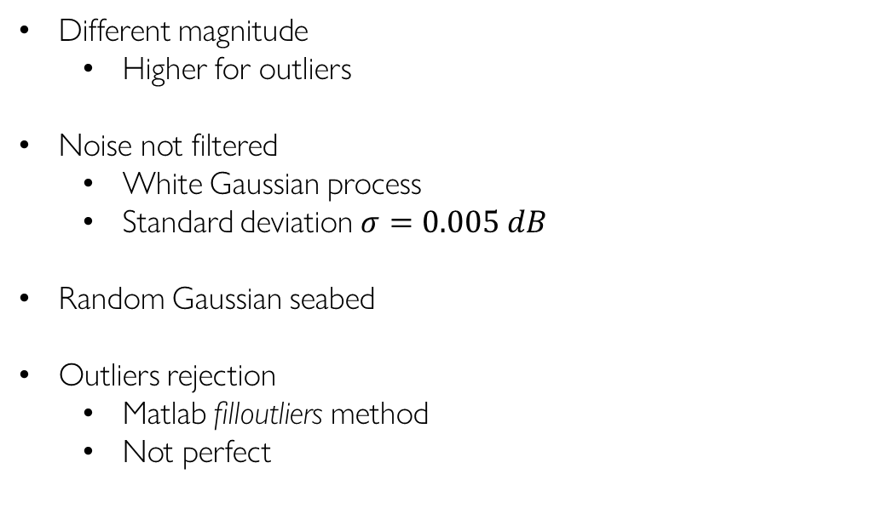
Outliers + noise
Different magnitude
Higher for outliers
Noise not filtered
White Gaussian process
Standard deviation $σ=0.005 dB$
Random Gaussian seabed
Outliers rejection
Matlab filloutliers method
Not perfect

Slide 5
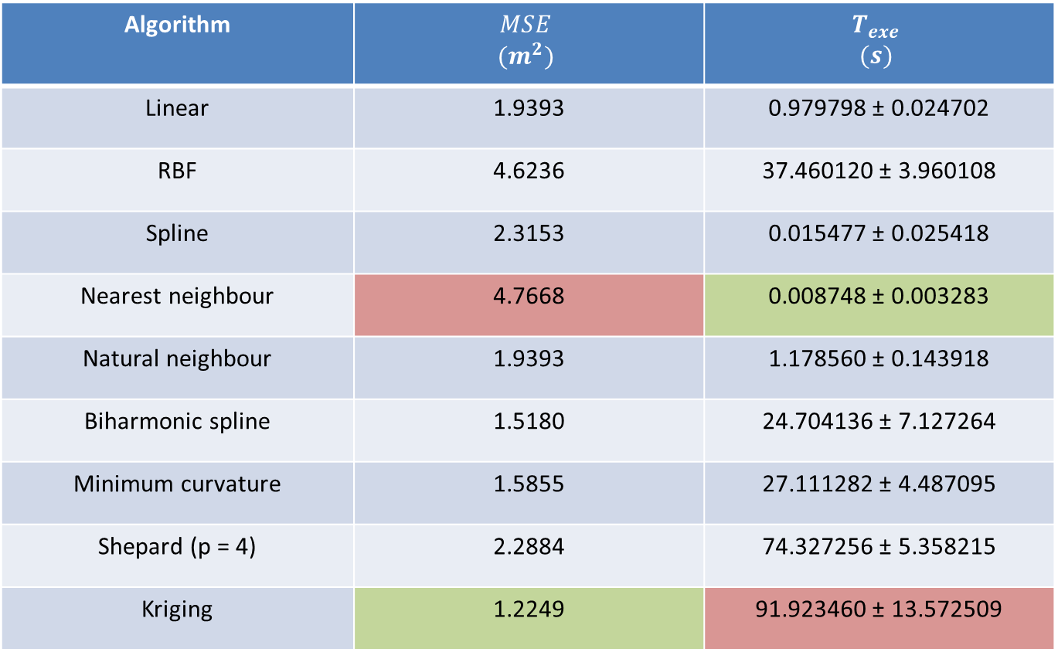
Gaussian seabed: results
Algorithm | $$MSE$$ $$(m^{2})$$ | $$T_{exe}$$ $$(s)$$
Linear | 1.9393 | 0.979798 ± 0.024702
RBF | 4.6236 | 37.460120 ± 3.960108
Spline | 2.3153 | 0.015477 ± 0.025418
Nearest neighbour | 4.7668 | 0.008748 ± 0.003283
Natural neighbour | 1.9393 | 1.178560 ± 0.143918
Biharmonic spline | 1.5180 | 24.704136 ± 7.127264
Minimum curvature | 1.5855 | 27.111282 ± 4.487095
Shepard (p = 4) | 2.2884 | 74.327256 ± 5.358215
Kriging | 1.2249 | 91.923460 ± 13.572509

Slide 6
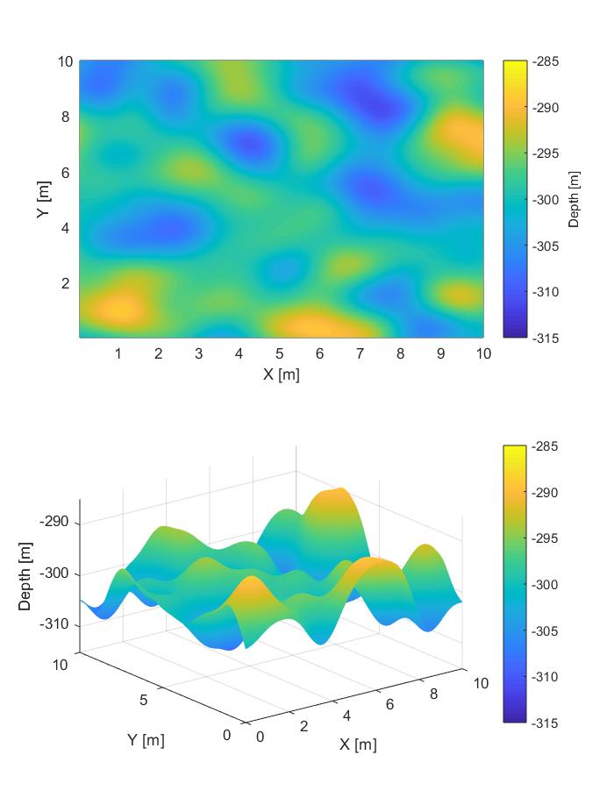
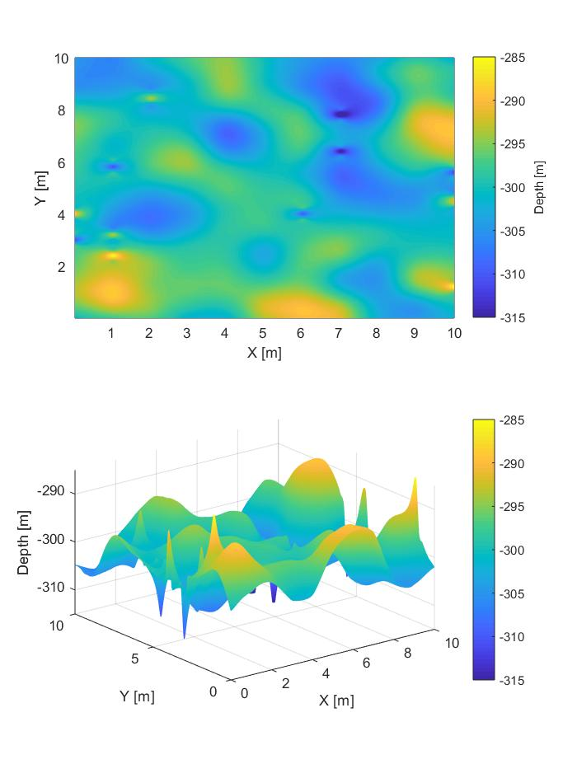
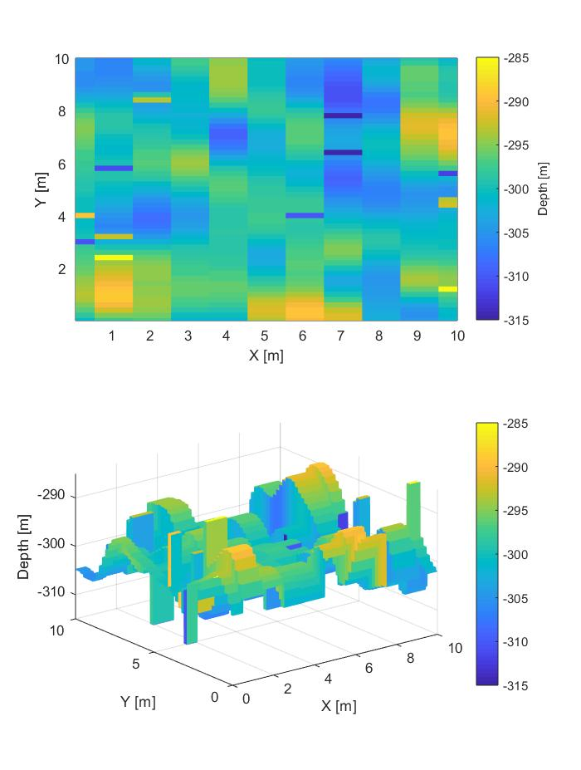
Gaussian seabed: results
Original
Kriging
Nearest neighbour

Slide 7

Gaussian seabed: results
Original
Kriging
Linear

Slide 8
About the mission: physical bounds
AUV is supposed to move back and forth
No steering among the inspected area
No navigation error
Transept spacing chosen by users
Y samples specified in the GUI
A bound can be imposed by the AUV used (point mass in our case, no bound)
AUV velocity constraints
No overlapping between consecutive signals
Echosounder characteristics

Slide 9
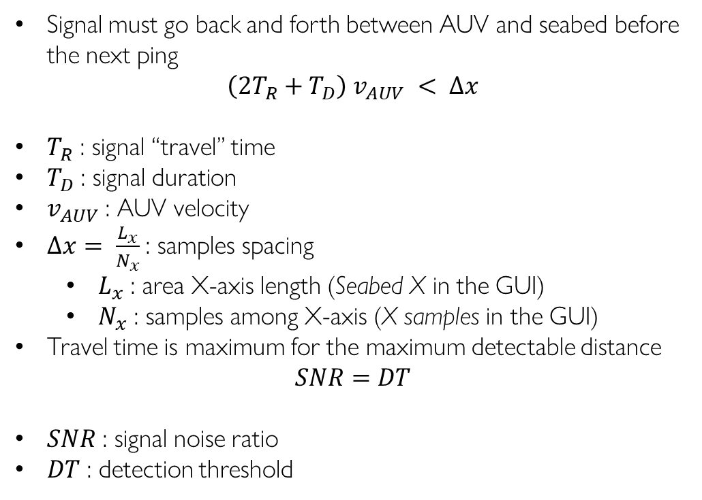
No signals overlapping bound
Signal must go back and forth between AUV and seabed before the next ping
$$\left(2T_{R}+T_{D}\right) v_{AUV} < ∆x$$
$T_{R}$ : signal “travel” time
$T_{D}$ : signal duration
$v_{AUV}$ : AUV velocity
$∆x= \frac{L_{x}}{N_{x}}$ : samples spacing
$L_{x}$ : area X-axis length (Seabed X in the GUI)
$N_{x}$ : samples among X-axis (X samples in the GUI)
Travel time is maximum for the maximum detectable distance
$$SNR=DT$$
$SNR$ : signal noise ratio
$DT$ : detection threshold

Slide 10
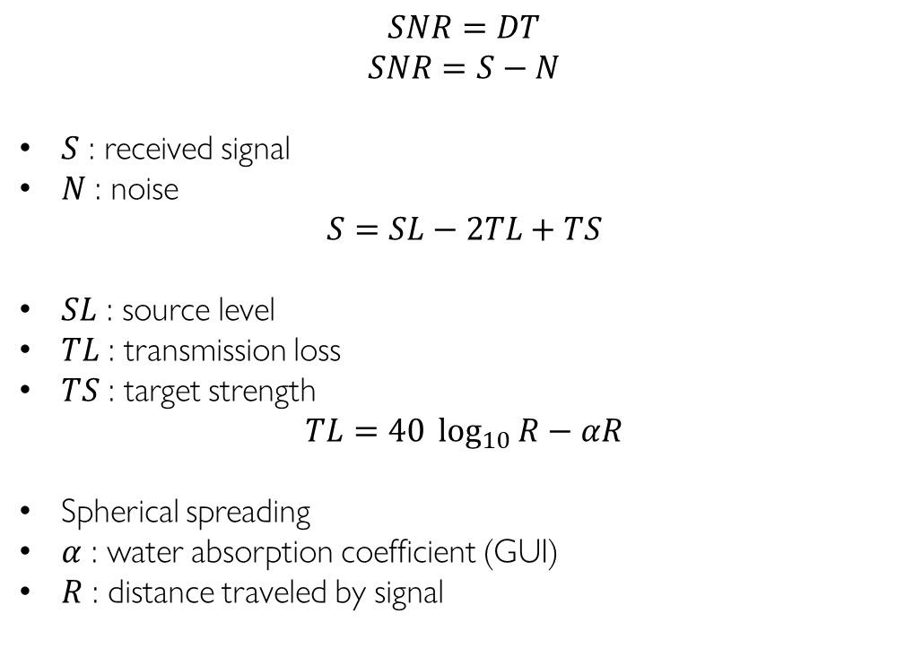
No signals overlapping bound
$$SNR=DT$$
$$SNR=S−N$$
$S$ : received signal
$N$ : noise
$$S=SL−2TL+TS$$
$SL$ : source level
$TL$ : transmission loss
$TS$ : target strength
$$TL=40 \log_{10}{R}−αR$$
Spherical spreading
$α$ : water absorption coefficient (GUI)
$R$ : distance traveled by signal

Slide 11


No signals overlapping bound
We need $R$ to compute travel time
$$TL=\frac{SL −DT+TS −N}{2}$$
Using this value we can found a solution for $R$ from the transmission loss equation
$$T_{R}= \frac{R}{c}$$
$c$ : sound speed
$$v_{AUV}<\frac{∆x}{2T_{R}+T_{D}}$$

Slide 12
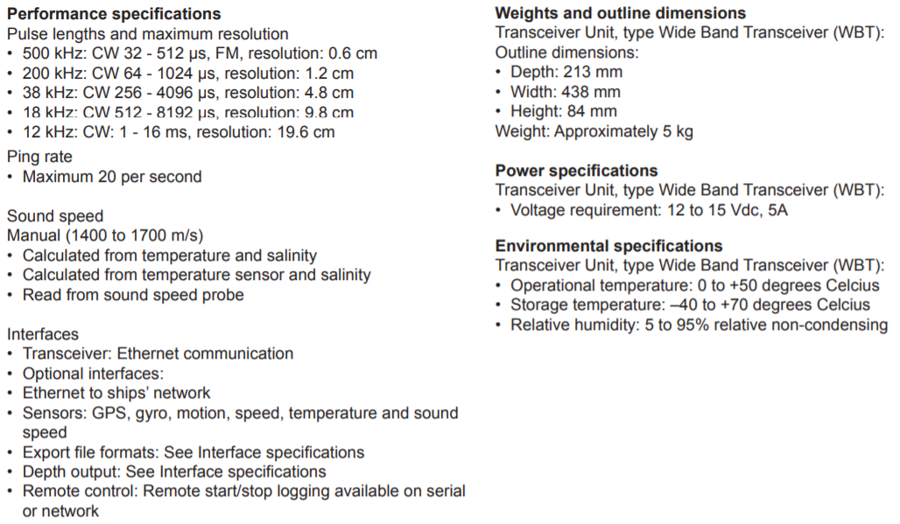

EA640 echosounder

Slide 13
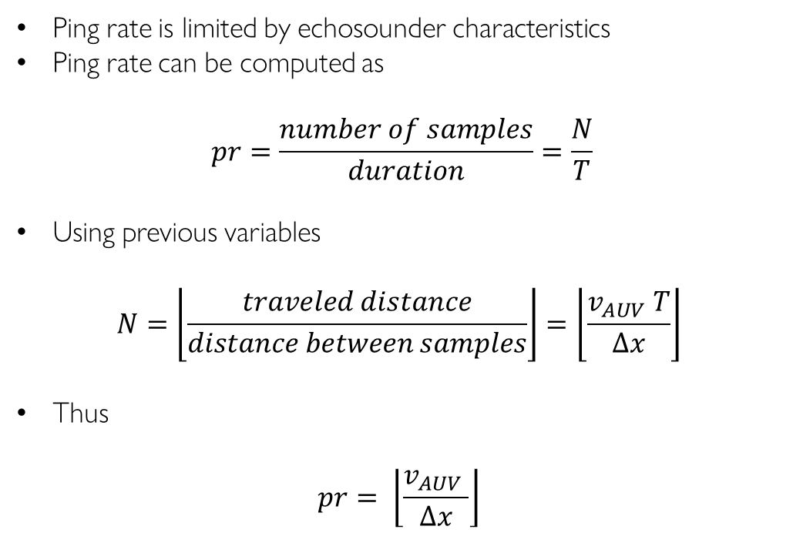
Ping rate bound
Ping rate is limited by echosounder characteristics
Ping rate can be computed as
$$pr=\frac{number of samples}{duration}=\frac{N}{T}$$
Using previous variables
$$N=\left\lfloor \frac{traveled distance}{distance between samples}\right\rfloor =\left\lfloor \frac{v_{AUV} T}{∆x}\right\rfloor$$
Thus
$$pr= \left\lfloor \frac{v_{AUV} }{∆x}\right\rfloor$$

Slide 14
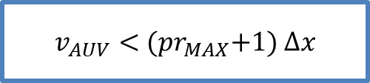

Ping rate bound
$$pr< {pr}_{MAX}$$
$$\left\lfloor \frac{v_{AUV} }{∆x}\right\rfloor < {pr}_{MAX}$$
From floor function definition
$$\left\lfloor x\right\rfloor ≤x<\left\lfloor x\right\rfloor +1$$
$$\left\lfloor x\right\rfloor −1≤x−1<\left\lfloor x\right\rfloor$$
Thus
$$\frac{v_{AUV} }{∆x}−1< {pr}_{MAX}$$
$v_{AUV}<$ ${(pr}_{MAX}+1) ∆x$

Slide 15
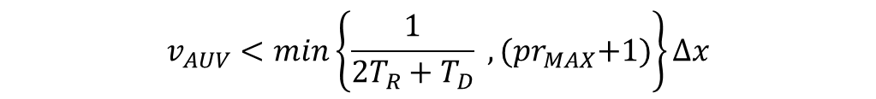
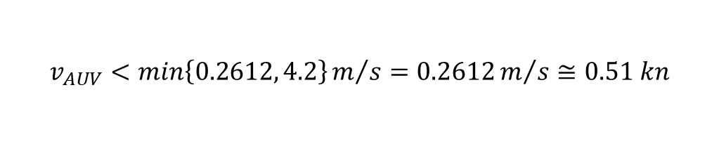
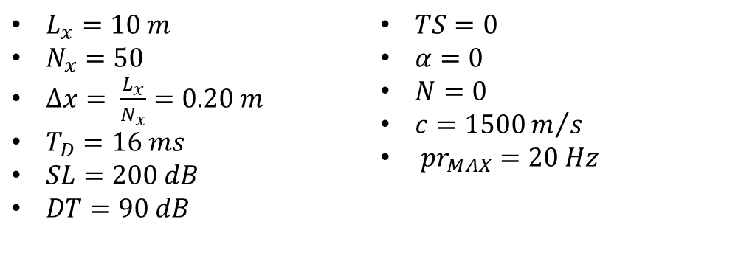
Example
$$v_{AUV}<min\left\{\frac{1}{2T_{R}+T_{D}} , {(pr}_{MAX}+1)\right\}∆x$$
$L_{x}=10 m$ $N_{x}=50$ $∆x= \frac{L_{x}}{N_{x}}=0.20 m$ $T_{D}=16 ms$ $SL=200 dB$ $DT=90 dB$ | $TS=0$ $α=0$ $N=0$ $c=1500m/s$ ${ pr}_{MAX} =20 Hz$
Ideal case
$$v_{AUV}<min\left\{0.2612, 4.2\right\}m/s=0.2612m/s≅0.51 kn$$
Notes:
R = 562.3413
T_R = 0.3749 s
1 kn = 0,514 m/s

Slide 16
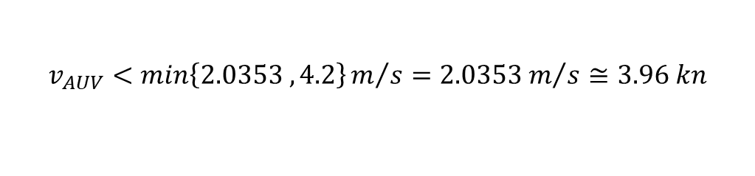
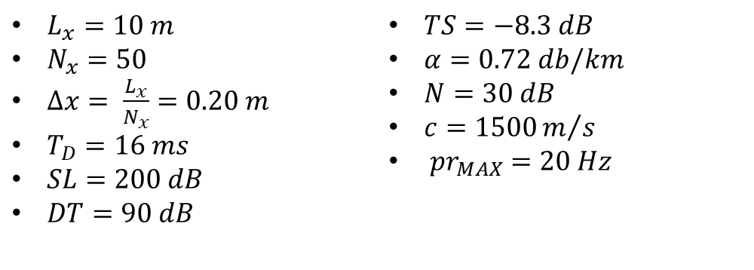
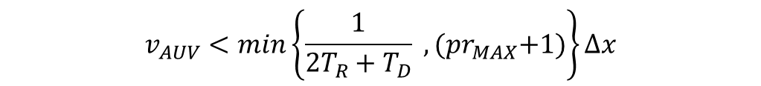
Example
$$v_{AUV}<min\left\{\frac{1}{2T_{R}+T_{D}} , {(pr}_{MAX}+1)\right\}∆x$$
$L_{x}=10 m$ $N_{x}=50$ $∆x= \frac{L_{x}}{N_{x}}=0.20 m$ $T_{D}=16 ms$ $SL=200 dB$ $DT=90 dB$ | $TS=−8.3 dB$ $α=0.72 db/km$ $N=30 dB$ $c=1500m/s$ ${ pr}_{MAX} =20 Hz$
Possible case
$$v_{AUV}<min\left\{2.0353 ,4.2\right\}m/s={2.0353 m}/s≅3.96 kn$$
Notes:
Sabbia fine
Acqua a 20°C
R =61.6991 m
T_R = 0.0411 s
1 kn = 0,514 m/s

Slide 17
Samples density
Users can change the number of samples
More samples
Samples affected by noise
Outliers are more likely to be present and not rejected
Higher computational complexity
Slower AUV
Less samples
Less data for training
Lower computational complexity
Lower probability of measuring critical points
Faster AUV (upper-bounded velocity)
Random Gaussian seabed for testing

Slide 18
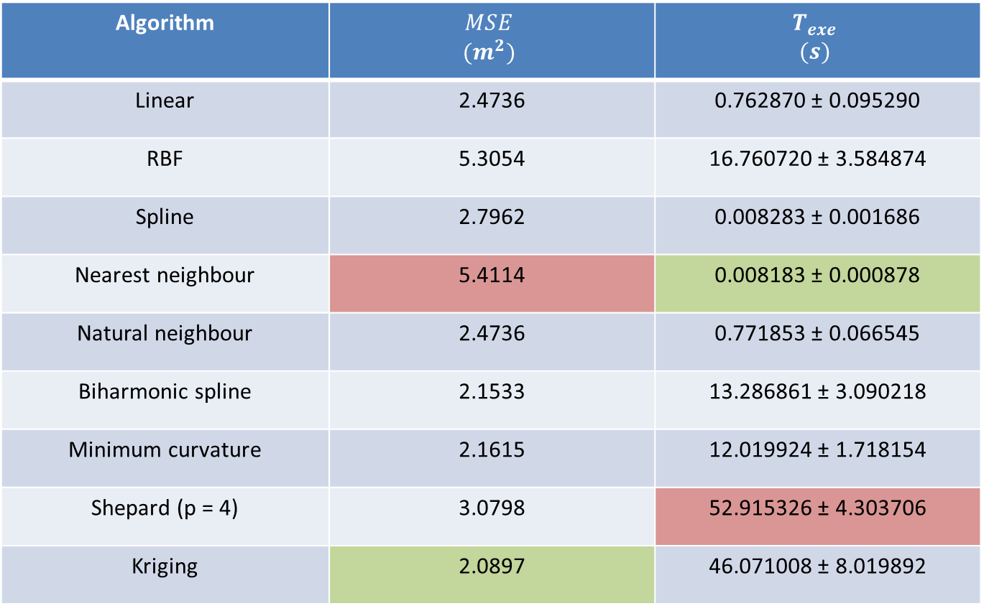
25 x 10 samples
Algorithm | $$MSE$$ $$(m^{2})$$ | $$T_{exe}$$ $$(s)$$
Linear | 2.4736 | 0.762870 ± 0.095290
RBF | 5.3054 | 16.760720 ± 3.584874
Spline | 2.7962 | 0.008283 ± 0.001686
Nearest neighbour | 5.4114 | 0.008183 ± 0.000878
Natural neighbour | 2.4736 | 0.771853 ± 0.066545
Biharmonic spline | 2.1533 | 13.286861 ± 3.090218
Minimum curvature | 2.1615 | 12.019924 ± 1.718154
Shepard (p = 4) | 3.0798 | 52.915326 ± 4.303706
Kriging | 2.0897 | 46.071008 ± 8.019892

Slide 19
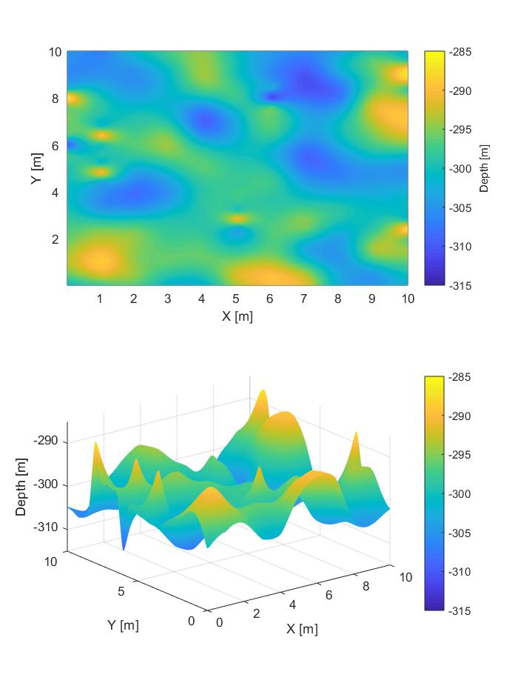
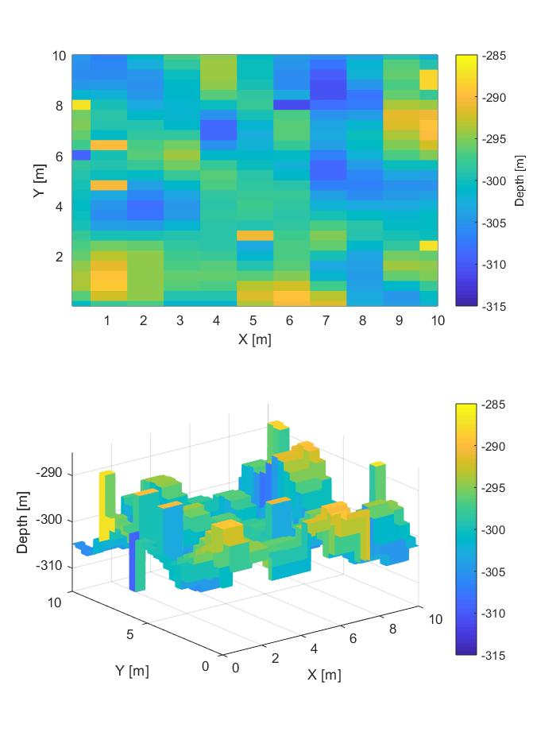
25 x 10 samples
Original
Kriging
Nearest neighbour

Slide 20
50 x 10 samples
Algorithm | $$MSE$$ $$(m^{2})$$ | $$T_{exe}$$ $$(s)$$
Linear | 1.9393 | 0.979798 ± 0.024702
RBF | 4.6236 | 37.460120 ± 3.960108
Spline | 2.3153 | 0.015477 ± 0.025418
Nearest neighbour | 4.7668 | 0.008748 ± 0.003283
Natural neighbour | 1.9393 | 1.178560 ± 0.143918
Biharmonic spline | 1.5180 | 24.704136 ± 7.127264
Minimum curvature | 1.5855 | 27.111282 ± 4.487095
Shepard (p = 4) | 2.2884 | 74.327256 ± 5.358215
Kriging | 1.2249 | 91.923460 ± 13.572509

Slide 21
50 x 10 samples
Original
Kriging
Nearest neighbour

Slide 22
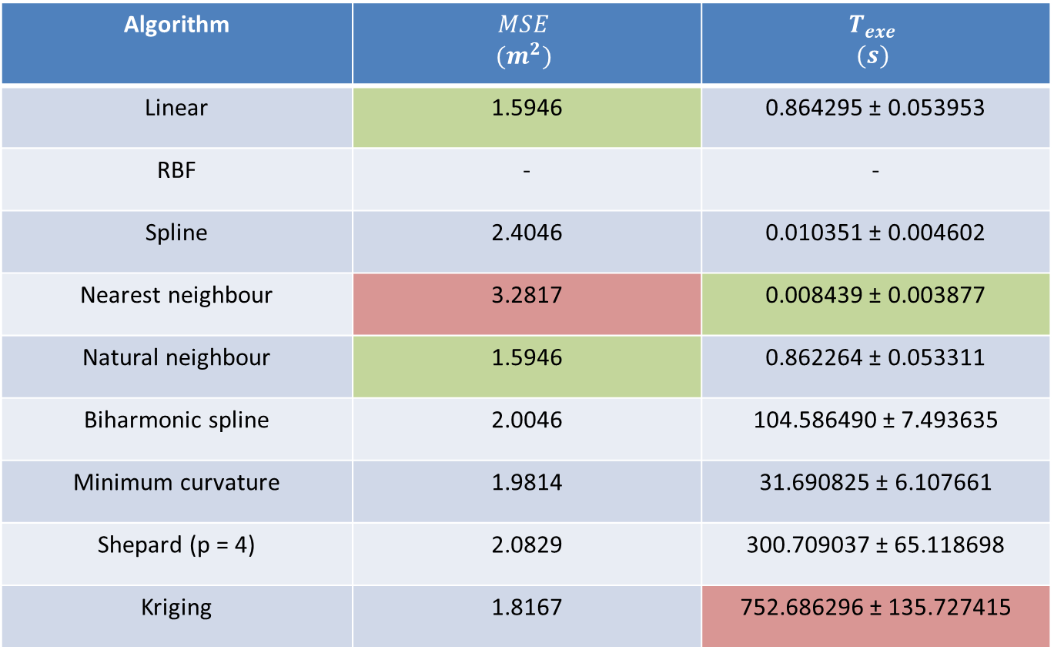
50 x 50 samples
Algorithm | $$MSE$$ $$(m^{2})$$ | $$T_{exe}$$ $$(s)$$
Linear | 1.5946 | 0.864295 ± 0.053953
RBF | - | -
Spline | 2.4046 | 0.010351 ± 0.004602
Nearest neighbour | 3.2817 | 0.008439 ± 0.003877
Natural neighbour | 1.5946 | 0.862264 ± 0.053311
Biharmonic spline | 2.0046 | 104.586490 ± 7.493635
Minimum curvature | 1.9814 | 31.690825 ± 6.107661
Shepard (p = 4) | 2.0829 | 300.709037 ± 65.118698
Kriging | 1.8167 | 752.686296 ± 135.727415

Slide 23
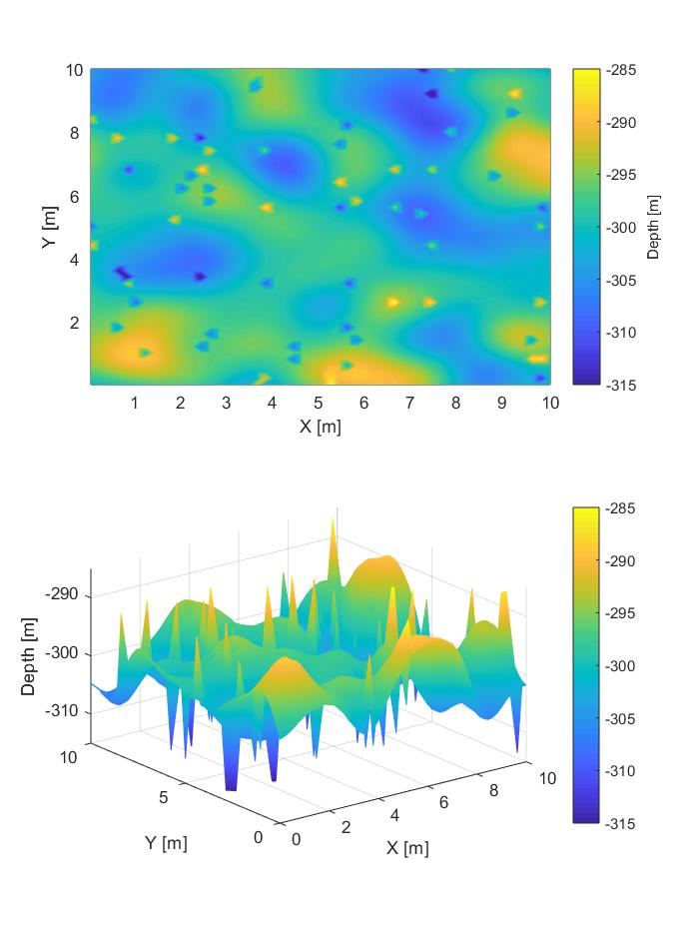
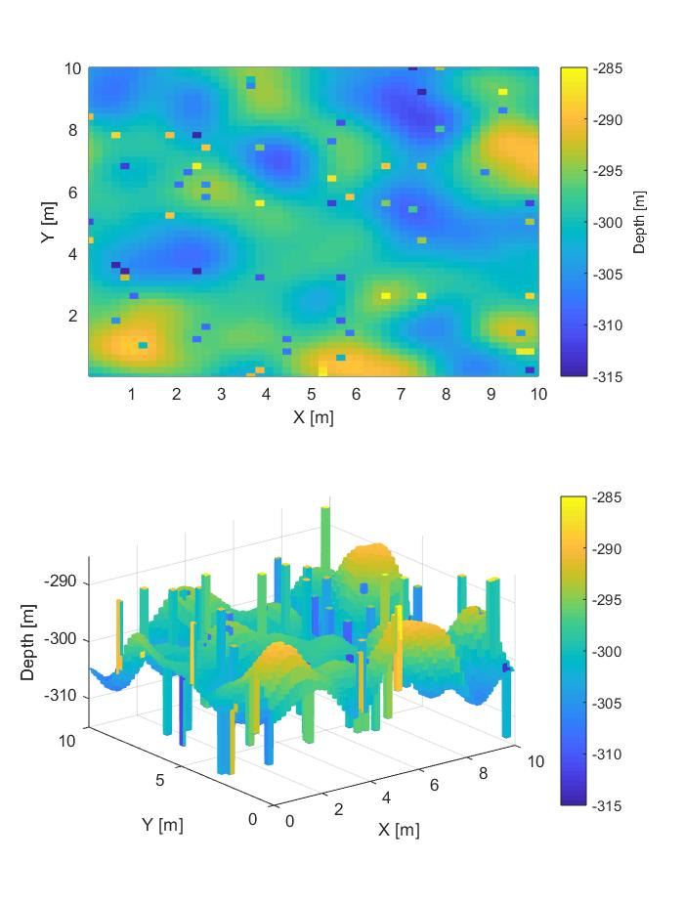
50 x 50 samples
Original
Natural neighbour
Nearest neighbour

Slide 24
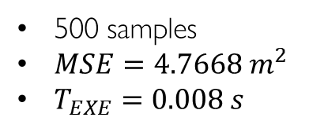
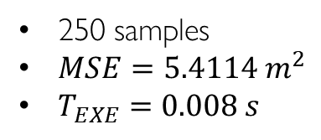
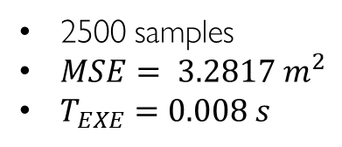
Nearest neighbour
250 samples
$MSE=5.4114 m^{2}$
$T_{EXE}=0.008 s$
500 samples
$MSE=4.7668 m^{2}$
$T_{EXE}=0.008 s$
2500 samples
$MSE= {3.2817 m}^{2}$
$T_{EXE}=0.008 s$

Slide 25

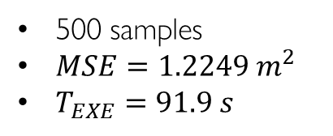
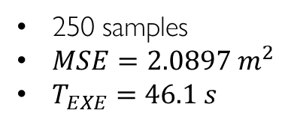
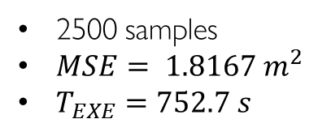
Kriging
250 samples
$MSE=2.0897 m^{2}$
$T_{EXE}=46.1 s$
500 samples
$MSE=1.2249 m^{2}$
$T_{EXE}=91.9 s$
2500 samples
$MSE= {1.8167 m}^{2}$
$T_{EXE}=752.7 s$

Slide 26
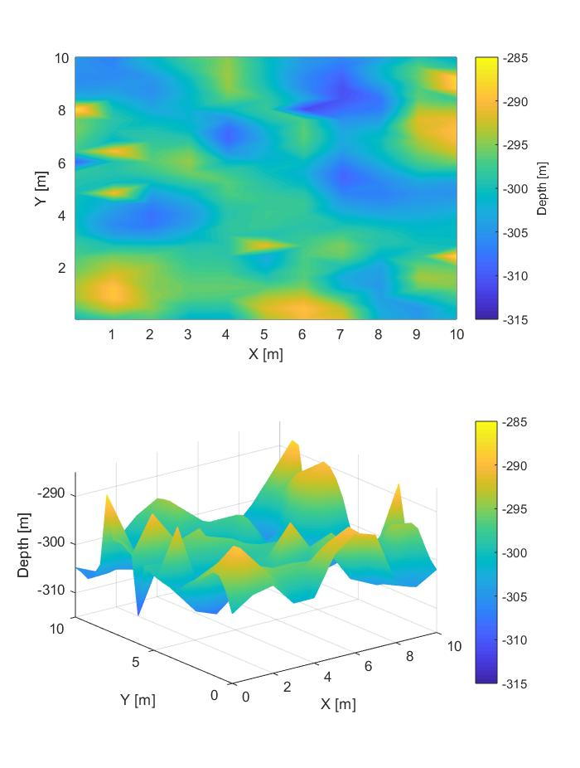
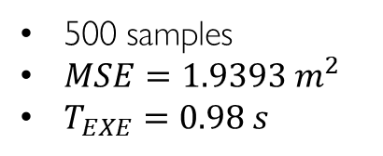
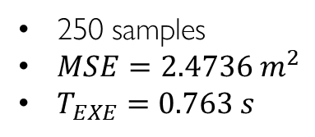
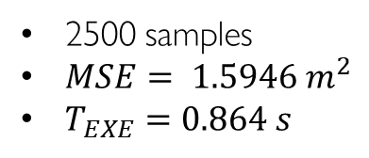
Linear
250 samples
$MSE=2.4736 m^{2}$
$T_{EXE}=0.763 s$
500 samples
$MSE=1.9393 m^{2}$
$T_{EXE}=0.98 s$
2500 samples
$MSE= {1.5946 m}^{2}$
$T_{EXE}=0.864 s$

Slide 27
To do
Noise filtering
Different outliers replacement
Path drawing

